Slide 1
OSCILLATORY MOTION AND WAVES
NJ-OER TOPIC-16

Slide 2
Learning Outcomes
Relate period, frequency and angular frequency for an oscillatory motion Distinguish between the motion parameters A,f,T,w and the dynamic properties such as mass, moment of inertia, spring coefficient, gravity etc. Calculate motion parameters from the dynamic properties Describe a simple harmonic oscillator equation Write the equation of motion using the motion parameters From a given equation of motion, estimate motion parameters and dynamic variables Explain the link between simple harmonic motion and waves. State characteristics of waves and standing waves Understand the role of wavelength in destructive and constructive interferences

Slide 3
Concepts
F= force k= spring constant x= displacement from equilibrium position f = frequency T= period ω= angular frequency A = Amplitude of displacement θ= angular displacement θmax= Amplitude of a pendulum ф= phase constant m = mass Vmax= maximum velocity amax= maximum acceleration λ = wavelength

Slide 4
Units
SI UNITS Force is in Newtons Frequency is in Hz angular frequency is in rad/sec Period is in seconds (s) angular displacement is in radians phase constant is in radians Mass is in Kg wavelength is in meters (m) Amplitude is in meters (m) Velocity is in m/s Acceleration is in m/s²

Slide 5
Formulas and Constants
f = 1/T f = 1/T ω= 2πf 2πf Springs F= -k(x-xo) E=½ k A² E=½ m vmax² x= A cos (ωt) x-oscillation starting at A x= A cos (ωt+ф) ω²= k/m Pendulum θ= θmax cos (ωt+ф) ω² =g/L Simple Pendulum ω² = mgR/I Physical Pendulum Waves v = λ f = λ /T

Slide 6
KEY STRATEGIES
f, T and ω are related, knowing one means knowing all f = 1/T ω= 2πf
Above equations applies to all Simple Harmonic Motion (SHM)
The equation that connects dynamic variables to kinematics are different for each system
ω²= k/m for spring ω²= k/m²= g/L for the simple pendulum
If the equation of motion is given, A, ω, ф can be found by matching the variables. Other unknowns can be calculated
x = 3.2 cos (5 t + 0.2)
x= A cos (ω t + ф )
If A, ω, ф are given or can be calculated, equation of motion can be found by substituting
Ф = 0 If the motion starts from xmax=A

Slide 7
CLASSWORK FOR SHM OF A SPRING
Mass "m" is oscillating on a spring with spring coefficient "k" along the x-axis with amplitude A. Complete the table below using the known values and equations
A Amplitude meters | f Frequency Hz | T Period s | w Angular Frequency radHZ | k Spring Coefficient N/m | m Mass kg | Energy Joules | Equation A cos(wt)
2.4 | 5.0 |  |  | 200
 |  |  |  |  | 4 |  | 5 cos(7 t)
 |  | 5 |  | 20 |  | 40 J
 |  |  |  | 9 |  |  | 3 cos(3.14 t)
x=Acos(w t) f=1/T w=2pi f w=sqrt(k/m) Energy=½ k A^2

Slide 8
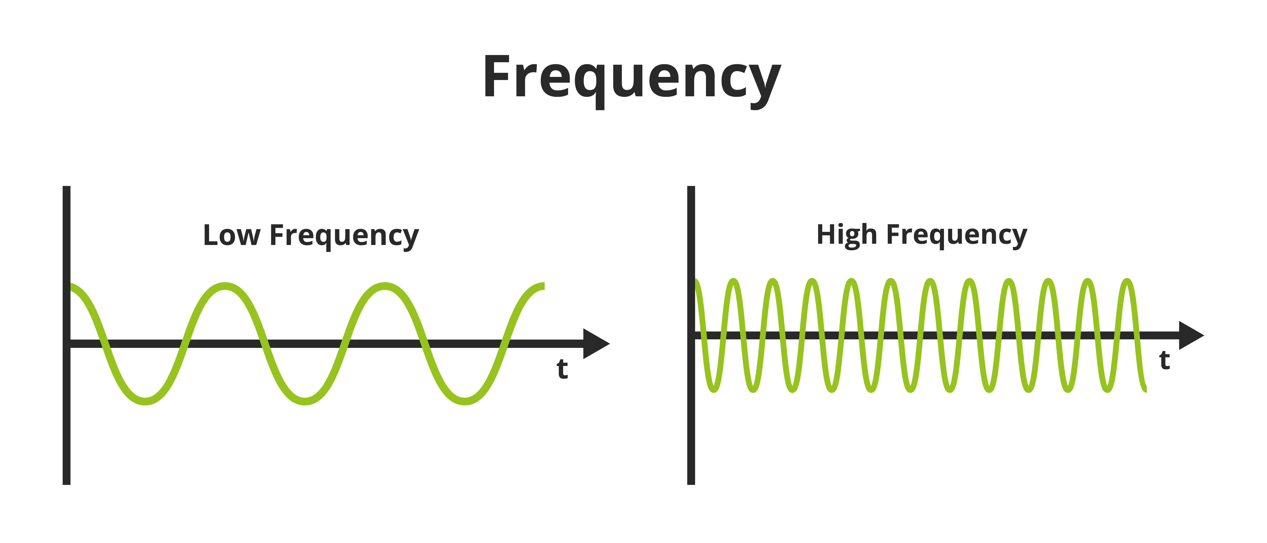
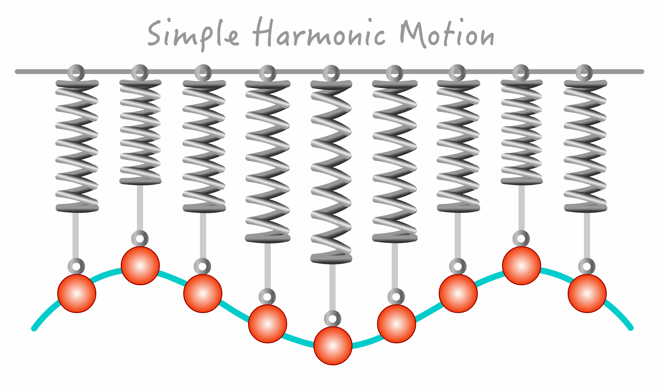
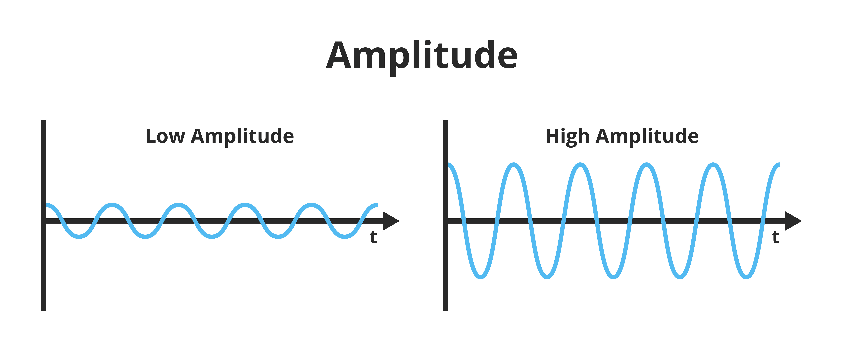
GRAPHING SIMPLE HARMONIC MOTION

Slide 9
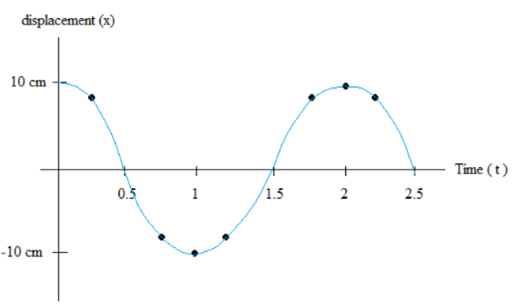
CLASSWORK ON GRAPHS
Q1)Determine the amplitude and the period of the simple harmonic motion on the graph
Q2) Graph a simple harmonic motion graph with amplitude of 2.2 m and frequency of 0.2 HZ
Q3) y = 4.2 cos (π t + π/4) is given. Graph the motion as y vs t.

Slide 10
ACTIVITY OSCILLATIONS
Determine the spring coefficient by measuring the period. Go to the link below.
https://phet.colorado.edu/sims/html/masses-and-springs/latest/masses-and-springs_en.html
Reduce damping to zero from the toolbar at the right, click on period trace
Drag the timer from the bottom right. Attached the mass to the spring and pull it down.
Adjust your mass and spring constant using the slider tools at the top.
Start your timer. In order to increase accuracy, you must count ten oscillations and stop the timer. (App works better at slow motion.)
Divide the measured time to ten, this should give you your period "T".
Using the values for mass and period calculate the spring coefficient using the equation. 𝑇² =4𝜋²𝑚/𝐾 Change the spring coefficient and repeat the activity k =4𝜋²𝑚/T²
Mass (kg) | Spring Constant | Time for 10 Oscillation | Period T (s) | k (N/m)
0.100 | small
0.200 | small
0.050 | medium
0.300 | large

Slide 11
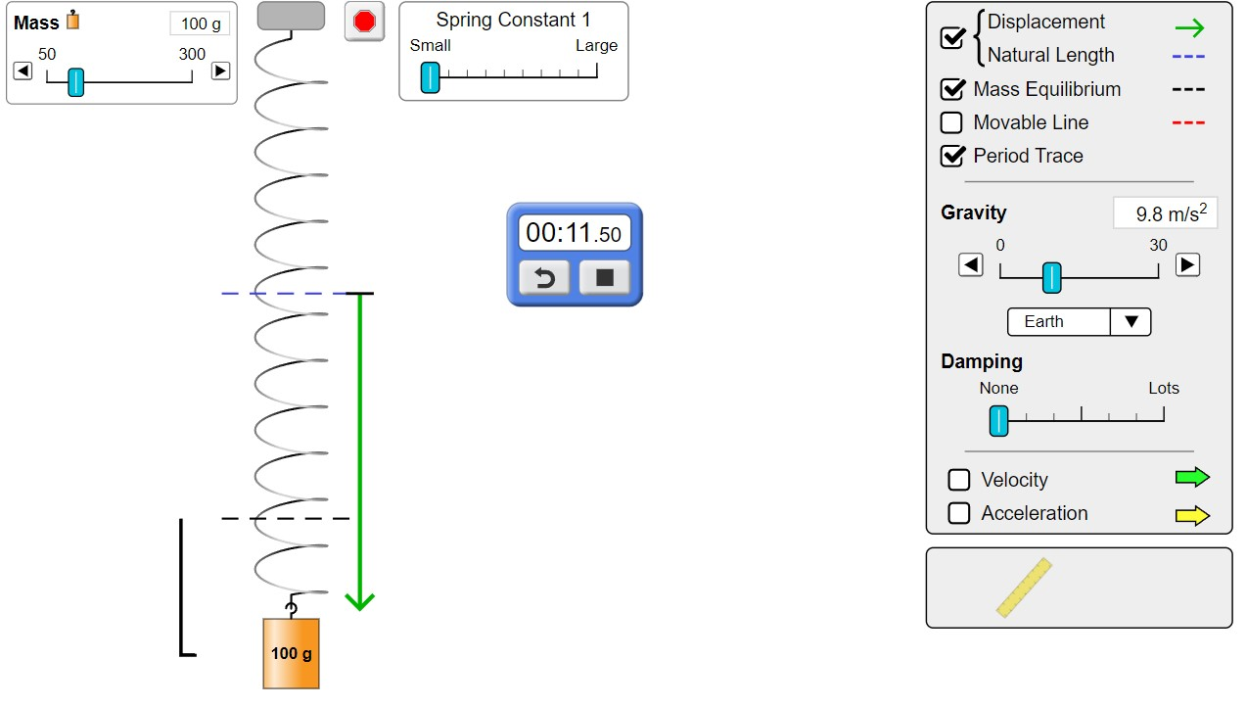
ACTIVITY OSCILLATION
Determine the spring coefficient by measuring the period for each of the case on the table using the PhET app
https://phet.colorado.edu/sims/html/masses-and-springs/latest/masses-and-springs_en.html
Mass (kg) | Spring Constant | Time for 10 Oscillation | Period T (s) | k (N/m)
0.100 | small
0.200 | small
0.050 | medium
0.300 | large

Slide 12
SIMPLE PENDULUM
It is not advisable to use w for the simple pendulum. Because w can be used for angular speed which is a variable and angular frequency which is a constant.

Slide 13
CLASSWORK SIMPLE PENDULUM
Mass "m" is attached to a string with length "L" and oscillating on a planet with gravitational constant g. Complete the table below using the known values and equations​
A Amplitude radians | f Frequency Hz | T Period s | Length meters | Gravity g m/s² | Equation A cos (2πf t)
0.4 | 5.0 |  |  | 9.8
 |  |  | 1.0 |  | 5 cos(7 t)
0.2 |  | 5 |  | 20
 |  |  |  | 9 | 3 cos(3.14 t)
θ=θmax cos(2 π f t) f=1/T 2 π f =sqrt(g/L)

Slide 14
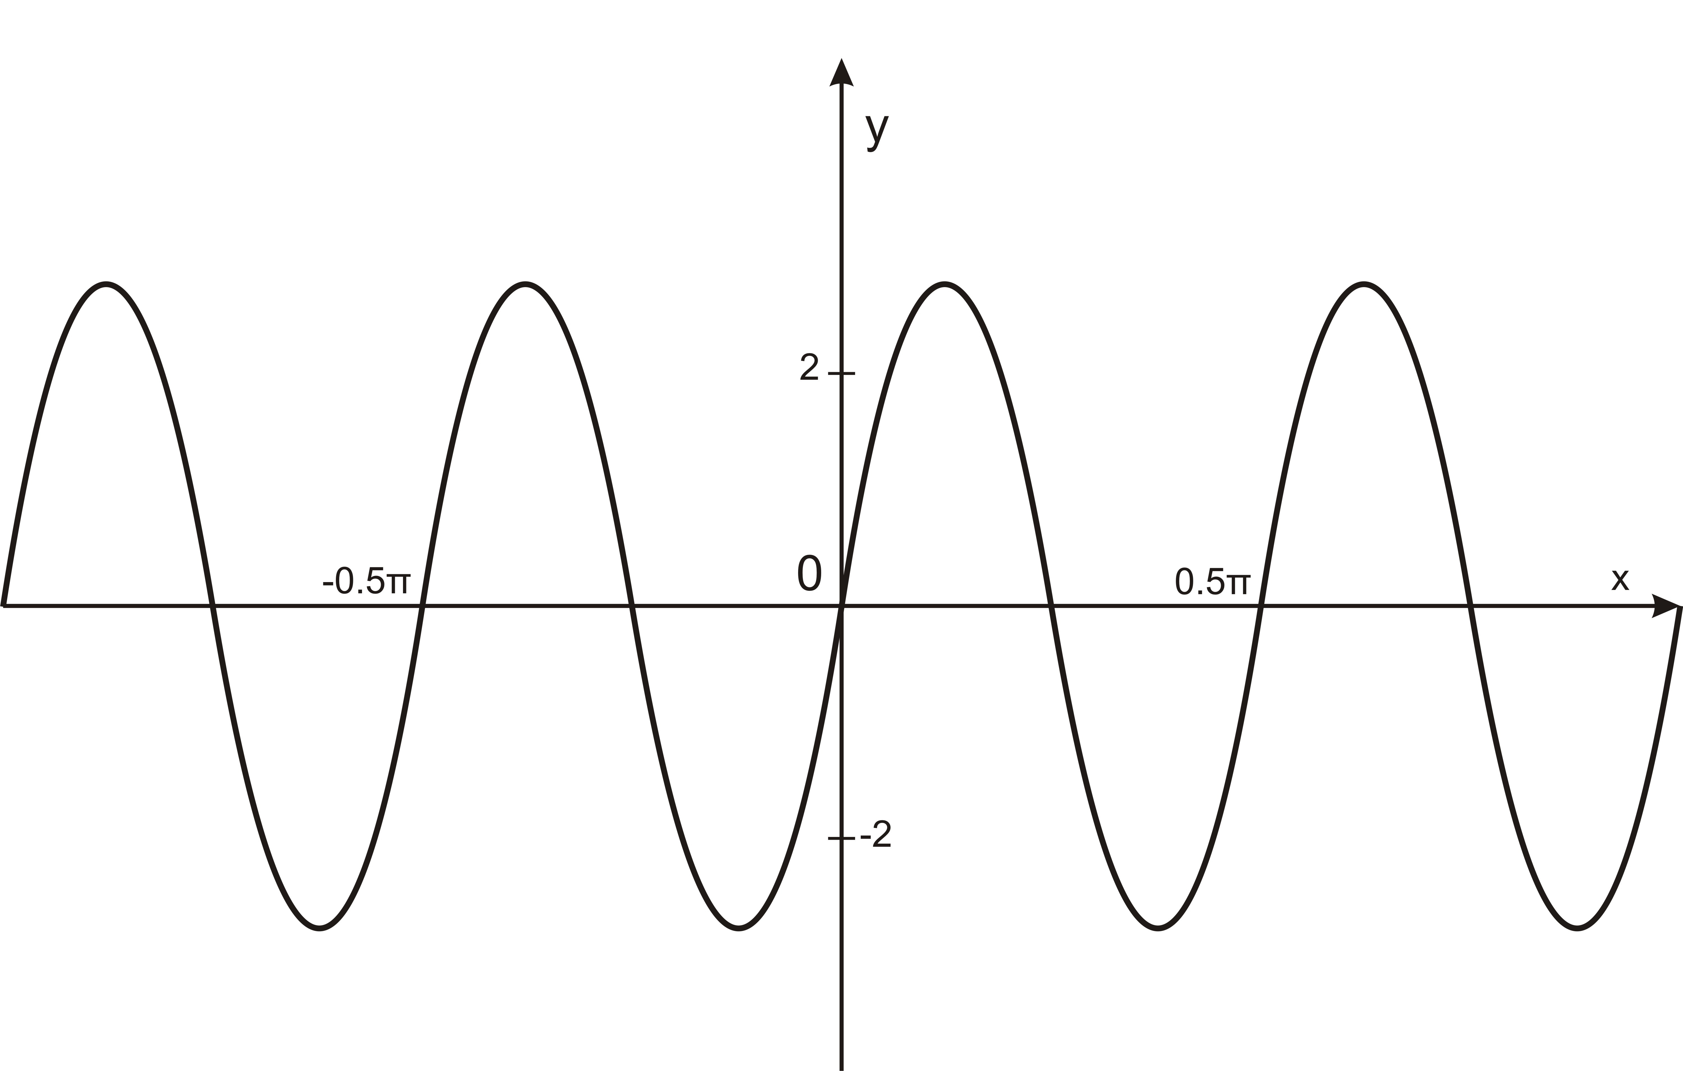
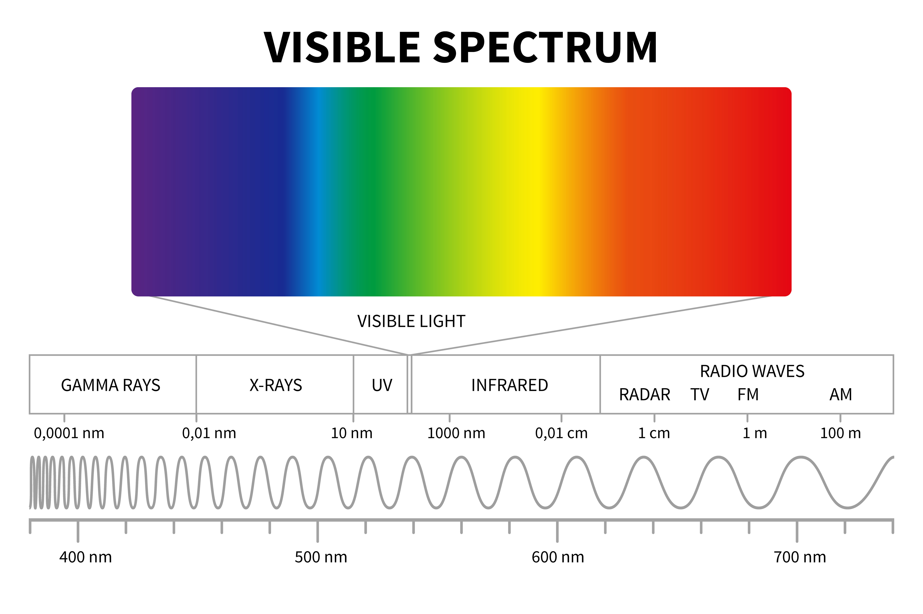
WAVES
v = λ f = λ /T
Intensity = Power/Area
Spherical Waves
I = P/(4πr²)
Superposition and Interference of two sources
A=A1 + A2 constructive
A= |A1-A2| destructive

Slide 15
CLASSWORK ON WAVES
Q1) What is the wavelength of an earthquake that shakes you with a frequency of 13.0 Hz and gets to another city 50.0 km away in 15.0 s?
Q2) Using the graph, find the wavelength of the wave that has a velocity of 4.0m/s.
Q3)Radio waves transmitted through space at the speed of light (3.0 10⁸ m/s) by the Voyager spacecraft have a wavelength of 0.120 m. What is their frequency?
Q4) Draw y vs x graph and y vs t graph of a wave with amplitude 2.0m, period 2.5 seconds and speed 4.0m/s
Q5) Two pulses with amplitude 0.2m and 0.3m interferes. Calculate the resultant amplitude if they are constructive or destructive

Slide 16
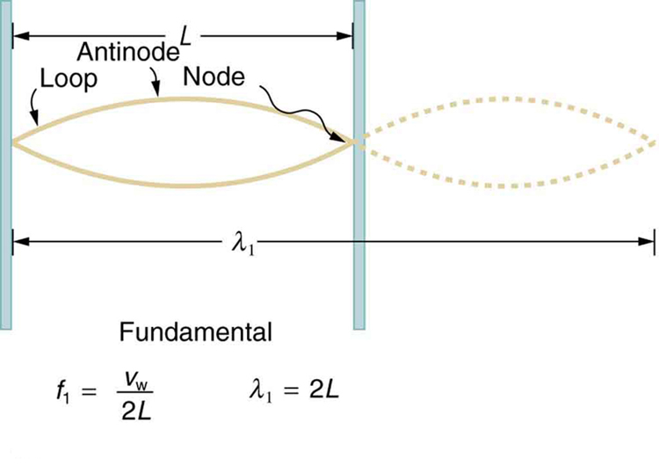
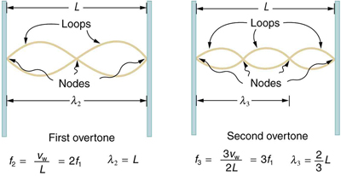
STANDING WAVES
For a standing wave, nodes are the points that does not oscillate
Antinodes are the maximums of the oscillation
Number of antinodes of a graph gives "n"
f = n Vw/(2L) where Vw is the wave velocity f is the frequency and L is the length
λ = 2L/n

Slide 17
CLASSWORK STANDING WAVES
Q1) For a standing wave on a 2 meters long string, the second overtone is f3=1500 HZ. Find the third overtone f4 and calculate its speed
Q2) Wave speed on a 0.25m long string is 460 m/s. Calculate the first three possible frequencies on that string
Q3) Draw a standing wave with 4 nodes on a 1.5 meters long string.
Q4) Find the wavelength for the fundamental frequency if f5=2125 Hz and wave speed is 450 m/s.

Slide 18
ADVANCED CLASSWORK FOR STANDING WAVES
A string instrument has length "L", mass "m" and it is under a force of tension "Ft". String produces sound with frequency "fn" by forming standing waves with n number of antinodes. Complete the table below using the known quantities and the formula.
f Frequency Hz | Wavelength (m) | n | Force of Tension Ft | Length (m) | Mass (kg) | Mass Density m/L | Velocity
f4=? |  | 4 |  | 0.50 | 0.004 |  | 400 m/s
f5=1000 Hz |  |  |  | 0.80 | 0.005
 | 0.25 |  |  | 0.75 | 0.006 |  | 420m/s
f6=? |  | 6 |  | 0.60 | 0.003
v = λ f = λ /T v²= Ft/(mu) mu=m/L λ=2L/n f = n v /2L

Slide 19
REFERENCES
Slide 1: Adobe id= 474180263 Image of sine curve science By kimkimchin
Slide 8 Left image: Adobe id= 406122528 Simple harmonic motion. Distance and displacement can be found from the graph of position and time for SHM. Metal spring. Hooke 's law. Mechanic and physics. School illustration ... By LuckySoul
Slide 8 Right top image: Adobe id= 392626558 Vector scientific or educational illustration of frequency isolated on a white background. The number of occurrences per time. Low frequency and high frequency. Temporal, spatial, angular ... By petrroudny
Slide 8 Right lower image: Adobe id= 471057505 Vector scientific illustration of the amplitude of a wave isolated on a white background. The measure of change in a single period. High energy and high amplitude, low energy and low ... By petrroudny
Slide 9: Gen-Ed-Phys-I Workbook by M.Tabanli and J. Meenu and Open Stax College Physics online textbook
Slide 11: Screenshot from PhET Interactive Simulations University of Colorado Boulder
Slide 12: Adobeid= 417867678 3d illustration of a simple pendulum from an inclined angleBy Rehan
Slide 14 Top left: Adobe id= 468809423 Physic illustration show component of wave By trinset
Slide 14 Lower left: Adobe id= 229007362 Visible light diagram. Color electromagnetic spectrum, light wave frequency. Educational school physics vector background. Illustration of spectrum diagram rainbow, infrared and ... By MicroOne
Slide 14 Right: Adobe id= 51999726 Trigonometry By tony4urban
Slide 16: Open Stax College Physics online textbook

